Slide 1
Personal Financial Planning: An Introduction
© 2018 McGraw-Hill Education Limited

Slide 2
Developing Personal Financial Goals
Financial goals are influenced by:
Personal values and attitudes towards money
Time frame in which you want to achieve your goals
Type of financial need that drives your goals
Your life situation
© 2018 McGraw-Hill Education Limited

Slide 3
Developing Personal Financial Goals
Factors that influence your financial goals include:
Timing of goals
Short-term, intermediate, and long-term goals
Goals for different financial needs
Consumable products goals
Food, clothing
Durable product goals
Appliances, cars, sporting equipment
© 2018 McGraw-Hill Education Limited

Slide 4
Developing Personal Financial Goals
Life Situation takes into consideration of personal factors:
Age, income, marital status, household size, personal beliefs, and employment situation
Influences your spending and savings patterns
As society changes, different types of financial needs evolve:
Married at later age
More households with two incomes
Single parents
Living longer
Caring for children and aging parents
© 2018 McGraw-Hill Education Limited

Slide 5
Developing Personal Financial Goals
Average person goes through four basic stages in personal financial management
Referred to as the life cycle approach to financial planning
1. Early years (until the mid-30s)
Focus on creating an emergency fund, saving for down payment on house or condo, purchasing life insurance, start thinking about retirement
© 2018 McGraw-Hill Education Limited

Slide 6
Developing Personal Financial Goals
2. Middle years (mid-30s to mid-50s)
Focus on building wealth by paying down mortgage and increasing savings and investments
3. Middle Years (50s+)
Focus is on providing an adequate retirement fund
4. Retirement Years
Focus is on the efficient management of previously acquired wealth
© 2018 McGraw-Hill Education Limited

Slide 7
Developing Personal Financial Goals
Other events that influence your life situation include:
Graduation (at various levels of education)
Engagement and marriage
Birth or adoption of a child
Career change or move to a new area
Dependent children leaving home
Changes in health
Divorce
Retirement
Death of spouse or other family member
© 2018 McGraw-Hill Education Limited

Slide 8
Developing Personal Financial Goals
Common financial goals and activities include:
Obtain appropriate career training
Create an effective financial record keeping system
Develop a regular savings and investment program
Accumulate an appropriate emergency fund
Purchase appropriate types and amounts of insurance coverage
Create and implement a flexible budget
Evaluate and select appropriate investments
Establish and implement a plan for retirement goals
Make a will and develop an estate plan
© 2018 McGraw-Hill Education Limited

Slide 9
Developing Personal Financial Goals
Life Situation and Specialized Financial Activities
1. Young, single (18–35)
• Establish financial independence
• Obtain disability insurance to replace income during prolonged illness
• Consider home purchase
© 2018 McGraw-Hill Education Limited

Slide 10
Developing Personal Financial Goals
Life Situation and Specialized Financial Activities
2. Young couple with children under 18
• Carefully manage the increased need for the use of credit
• Obtain an appropriate amount of life insurance for the care of dependants
• Use a will to name a guardian for children
© 2018 McGraw-Hill Education Limited

Slide 11
Developing Personal Financial Goals
Life Situation and Specialized Financial Activities
3. Single parent with children under 18
• Obtain adequate amounts of health, life, and disability insurances
• Contribute to savings and investment funds for children’s higher education
• Name a guardian for children and make other estate plans
© 2018 McGraw-Hill Education Limited

Slide 12
Developing Personal Financial Goals
Life Situation and Specialized Financial Activities
4. Young dual-income couple, no children
• Coordinate insurance coverage and other benefits
• Develop savings and investment programs for changes in life situation (larger house, children)
• Consider tax-deferred contributions to retirement fund
© 2018 McGraw-Hill Education Limited

Slide 13
Developing Personal Financial Goals
Life Situation and Specialized Financial Activities
5. Older couple (+50), no dependent children at home
• Consolidate financial assets and review estate plans
• Obtain health insurance for post-retirement period
• Plan retirement housing, living expenses, recreational activities, and part-time work
© 2018 McGraw-Hill Education Limited

Slide 14
Developing Personal Financial Goals
Life Situation and Specialized Financial Activities
6. Mixed-generation household (elderly individuals and children under 18)
• Obtain long-term health care insurance and life/disability income for care of younger dependants • Use dependant care service, if needed
• Provide arrangements for handling finances of elderly if they become ill
• Consider splitting investment cost, with elderly getting income while alive and principal going to surviving relatives
© 2018 McGraw-Hill Education Limited

Slide 15
Developing Personal Financial Goals
Life Situation and Specialized Financial Activities
7. Older (+50), single
• Make arrangements for long-term health-care coverage • Review will and estate plan
• Plan retirement living facilities, living expenses, and activities
© 2018 McGraw-Hill Education Limited

Slide 16
Developing Personal Financial Goals
Financial goals should:
Be realistic
Be stated in specific, measurable terms
Have a time frame
Indicate the type of action to be taken.
© 2018 McGraw-Hill Education Limited

Slide 17
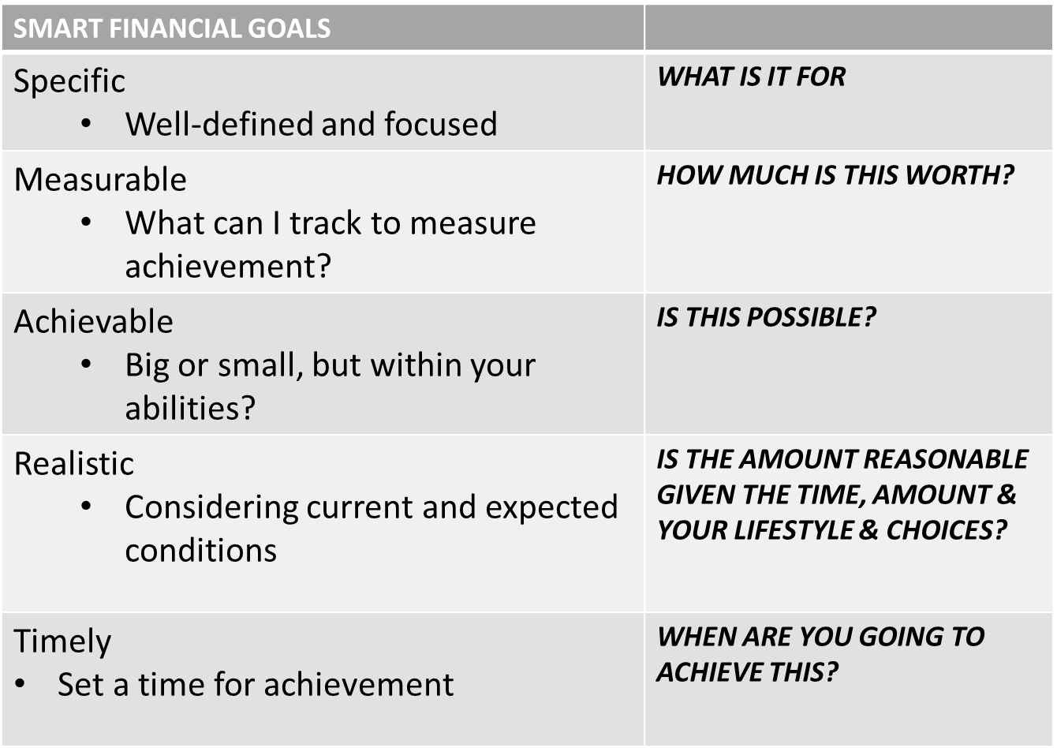
DEVELOP SMART GOALS…

Slide 18
Achieving Financial Goals
Components of personal financial planning include:
Obtaining (Unit1)
Planning (Units 2, 3)
Saving (Unit 4)
Borrowing (Units 5,6)
Spending (Unit 7)
Managing Risk (Units 8, 9)
Investing (Units 10-13)
Retirement and Estate Planning (Units 14,15)
© 2018 McGraw-Hill Education Limited

Slide 19
Achieving Financial Goals
© 2018 McGraw-Hill Education Limited

Slide 20
Achieving Financial Goals
A financial plan is formalized report that:
Summarizes your current financial situation.
Analyzes your financial needs.
Recommends future financial activities.
Your financial plan can be created by you, done with assistance from a financial planner, or made using a money management software package.
© 2018 McGraw-Hill Education Limited

Slide 21
Achieving Financial Goals
Develop good financial habits.
Use a spending plan to stay within your income, allowing you to save and invest for the future.
Have appropriate insurance protection to prevent financial disasters.
Become informed about tax and investment alternatives.
Achieving your financial objectives requires:
A willingness to learn.
Appropriate information sources.
© 2018 McGraw-Hill Education Limited

Slide 22
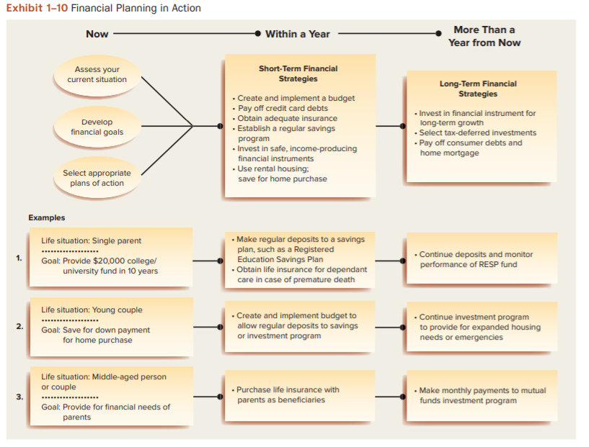
Achieving Financial Goals
© 2018 McGraw-Hill Education Limited

Slide 23
Achieving Financial Goals
IMPLEMENTING YOUR FINANCIAL PLAN
The most important strategy for success is the development of financial habits that contribute to both short-term satisfaction and long-term financial security:
1. Using a well-conceived spending plan helps you stay within your income while you save and invest for the future. The main source of financial difficulties is overspending
2. Having appropriate insurance protection helps you prevent financial disasters
3. Becoming informed about tax and investment alternatives helps you expand your financial resources.

Slide 24
Summary
Analyze the process for making personal financial decisions
Determine current financial situation
Develop financial goals
Identify alternative courses of action
Evaluate alternatives
Create and implement a financial plan
Re-evaluate and revise the financial plan
© 2018 McGraw-Hill Education Limited

Slide 25
Summary
Develop personal financial goals
Goals should be realistic
Be stated in specific, measurable
terms
Have a time frame
Indicate the type of action to be taken
Affected by person’s values, attitudes towards money and life situation
© 2018 McGraw-Hill Education Limited

Slide 26
Summary
Assess economic factors that influence personal financial planning
Consumer prices
Interest rates
Employment opportunities
© 2018 McGraw-Hill Education Limited

Slide 27
Summary
Determine personal and financial opportunity costs associated with personal financial decisions.
Every decision involves a trade off
Personal opportunity costs include time, effort and health
Financial opportunity costs based on time value of money
Future and present value calculations enable you to measure increased value (or lost interest) from saving, investing, borrowing or purchasing decisions
© 2018 McGraw-Hill Education Limited

Slide 28
Summary
Identify strategies for achieving personal financial goals for different life situations
Requires specific goals combined with spending, saving, investing and borrowing strategies
Based on your personal life situation and various social and economic factors
© 2018 McGraw-Hill Education Limited

Slide 29
Who can help you?
Financial Planning Specialists
Accountants
Bankers
Credit counselors
Certified Financial Planners
Insurance agents/brokers
Investment Brokers
Lawyers
Real Estate Agents
Tax Preparers
© 2018 McGraw-Hill Education Limited

Slide 30
Who can help…?
Financial planners are categorized based on the method of compensation
Fee-only planners
Fee-and-commission planners
Commission-only planners
Do you need a financial planner?
Your income
Your willingness to make independent decisions
© 2018 McGraw-Hill Education Limited

